Slide 1
Final Project IBM Analytics
Author : Angélica Sánchez Orth
Date : 12/11/2020

Slide 2
Agenda
Introduction
External Resources
Data visualization
Data Exploration
FourSquare Output
Clustering
Conclusion & Recomendations
References

Slide 3
Introduction
For the final project of IBM Analytics course, it was requested to perform an analysis using the different skills learned in the course and Foursquare to explore location data for one or more cities.
We have decided to explore México and other country with similar population, and analyze how the foreign cuisine is positioned in the other country. We will not analyze all type of cuisines, but only those local cuisines for each country, in other words, we will analyze Mexican Cuisine in the other country and Cuisine X (because at this point we don’t know which country we are going to use) for Mexico.
With this information, we pretend to see how developed are those foreign cuisines for similar cities of each countries. This could be the starting point to understand the distribution of the foreign cuisine on each city, and maybe at the end we conclude if it’s convenient to open the local cuisine on the other country or not.

Slide 4
External resources
Data was gathered from :
World Bank : Population by Country
Wikipedia : Tokyo wards
INEGI : Mexico Population by state
e-sat : Japan Population by perfecture

Slide 5
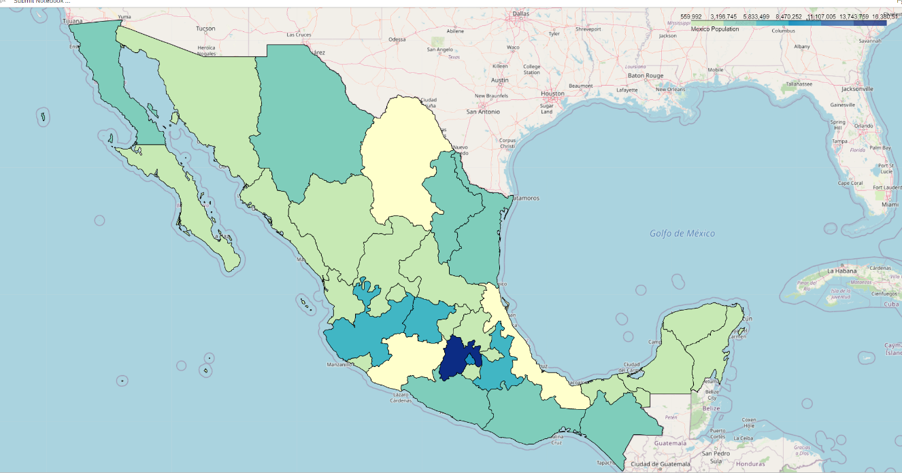
Data Visualization México
Mexico has 31 states and México City (32 states), all of them are divided into municipalities . Mexico City is divided into 16 delegaciones or municipalities.
State | Population | Hab/km2
Mexico | 16,225,409 | 655,9
Mexico City (CDMX) | 8,985,339 | 5,936.8

Slide 6
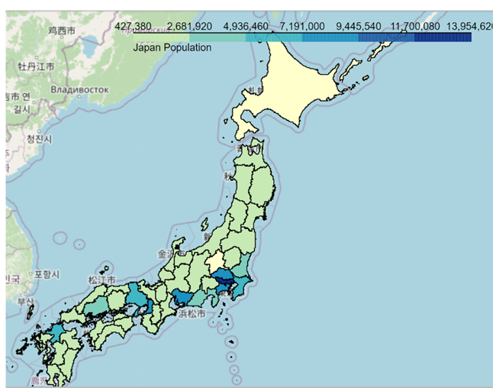
Data Visualization Japan
Japan has 47 prefectural entities and Tokyo has 23 municipalities or special wards (together make up the core and the most populous part of Tokyo Metropolis, Japan).
Perfecture | Population | Hab/km2
Tokyo | 13,822,000 | 6,158
Kanagawa | 9,177,000 | 3,770

Slide 7
Data Exploration México Tokyo
FourSquare input
Ward : All Wards
Category : Mexican Restaurant
Radius : 500
Limit : 100
Colonia ALVARO OBREGON
Category : Japanese Restaurant
Radius : 500
Limit : 100

Slide 8
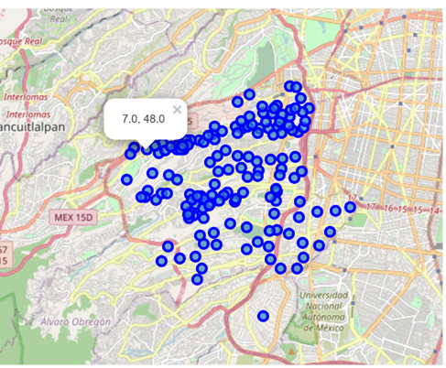
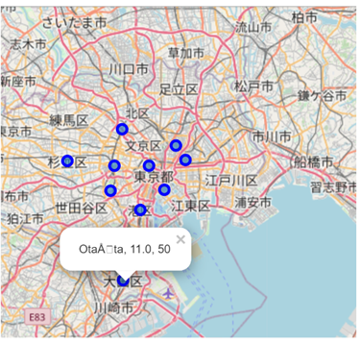
Foursquare Output México Tokyo
All colonias on Alcaldía ALVARO OBREGON with Japanesse Restaurants
Label : Japanese Restaurants, Mexican Restaurants
All ward on Tokyo with Mexican Restaurants
Label : Ward name, Mexican Restaurants, Japanese Restaurants

Slide 9
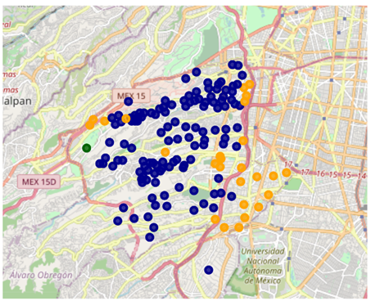
Clustering - México
Cluster 2: (darkgreen) One Colonia has the total of the 16 Japanese restaurants in this Cluster, this represents 4.3% of the Japanese Restaurants total found in Alvaro Obregón. This is a cluster with a lot of new residentials developments and a lot of variety of choices of cuisines. Urban development is hugh and lot of investment in infrastructure has been done to communicate this Colonia with the rest. I think we will see more services on the following years.
Cluster 0 (darkblue) : Majority of the Colonias belong to this Cluster, but the range of Japanese restaurant are between 1-3 per Colonia, this represents 55.8% of the Japanese Restaurant total found in Alvaro Obregón.
.
Cluster 1: (darkyellow) : It include 26 colonias, and has between 4 and 9 Japanese restaurants, this represents 40.0 % of the Japanese Restaurant total found in Alvaro Obregón.

Slide 10
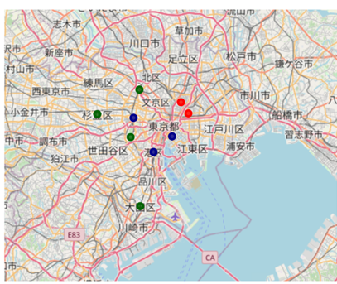
Clustering - Tokyo
Cluster 0 (darkblue) : a range from 11 to 16 mexican restaurants belong to this cluster and represents 14.8% of the total Mexican restaurants in Tokyo. This cluster has districts with very popular spots, shopping malls, corporate offices (Amex, Microsoft, Iwatsu Electric,etc. ), business centers, residential and public areas, and could be the reason why this cluster has the majority of the mexican restaurants (due to the diversity of services).
Cluster 1 (darkgreen) : a range from 1 to 5 mexican restaurants belong to this cluster and represents 12.8% of the total Mexican restaurants in Tokyo. This cluster include Shinjuku which is the most important Neighorhood on West Tokyo with lots to shopping, restaurants and night live, but it seems to be that Mexican cuisine is not well established here.
Cluster 2 (red) : : a range from 6 to 7 mexican restaurants belong to this cluster and represents 16.7% of the total Mexican restaurants in Tokyo. Some spot here include the Skeytree and the oldest temple in Tokyo and as with Cluster 1, Mexican cuisine is not well established here.

Slide 11
Conclusions
Regarding México City (Alcaldía Alvaro Obregón) I would say that due to the strong social contrast on this Alcaldía, where on one hand there are exclusive residential zones focus on high and medium-high classes, on the other hand it also includes medium-low and low classes. I would suggest to do a segregation based on income in order to reach the right target.
Regarding Tokyo, If I should have to do a recommendation for opening a new Mexican restaurant, I will certainly look for more information on districts in Cluster 0.
I see similarities on Cluster0 among the two cities : lot of services besides restaurants (residentials developments, corporate offices) and a diverse variety of other services.

Slide 12
Recommendations
To improve the outcome of this project, I would definitively :
I would not explore all Wards in Tokyo, but only a district;
b) I would include variables like income, Land price, security index and other that could help to have a stronger result;
c) explore Foursquare on a deeper level to get for instead : quality, price, type of restaurant, average cost of meal or other characteristics that will help to take a more accurate decision.
Related with the tools, I can say there are other platforms that provide similar information to Foursquare, like Yelp, Tripadvisor, Wikitravel, Swarm, Loopt, whrrl, etc., ¿which is the best? Definitely it depends on the company budget, target to achieve, type of analysis to be done, etc..
And last but not less important, like any other project, 75% of the project is planning – in this case, searching for accurate data – and the 35% left is execution. So, I suggest to take the time to search for the right sources and make sure to understand the stakeholder(s) needs.

Slide 13
References
All Notebooks in https://github.com/ASanchez3793/Coursera_Capstone/blob/main/Notebooks/
Notebook | Description
WorldBank.ipynb | Extract country with similar population to Mexico
MexicoJapanData.ipynb | Extract and clean data for México and Japan
MexicoVisualization ipynb | Generate maps and graphs for México
BeautifulSoap ipynb | Wrap Wikipedia page for Tokyo Wards
Japan Visualization ipynb | Maps and graph for Japan and Tokyo
FourSquareMEXJPN.ipynb | Explore venus with Foursquare and créate clusters

